Slide 1
Chapter 10: Recurrence Relations
謝孫源 講座教授
hsiehsy@mail.ntcku.edu.tw
國立成功大學 資訊工程系

Slide 2
Outline
The first-order linear recurrence relation
The second-order linear homogeneous recurrence relation with constant coefficients
The nonhomogeneous recurrence relation
The method of generating Functions

Slide 3
The First-Order Linear Recurrence Relation
The equation a_{n+1} = 3a_{n} is a recurrence relation with constant coefficients. Since a_{n+1} only depends on its immediate predecessor, the relation is said to be first order. The expression a₀ = A, where A is a constant, is referred to as an initial condition.
The unique solution of the recurrence relation a_{n+1} = da_{n}, where n ≥ 0, d is a constant, and a₀ = A, is given by a_{n} = Ad^{n}.

Slide 4
The First-Order Linear Recurrence Relation
Ex 10.1 : Solve the recurrence relation a_{n} = 7a_{n-1}, where n ≥ 1 and a₂ = 98.
a_{n} = a₀(7^{n}), a₂ = 98 = a₀(7²) ⇒ a₀ = 2, a_{n} = 2(7^{n}).
Ex 10.2 : A bank pay 6% annual interest on savings, compounding the interest monthly. If we deposit $1000, how much will this deposit be worth a year later?
p_{n+1} = (1.005)p_{n}, p₀ = 1000 ⇒ p_{n} = p₀(1.005)^{n}
p₁₂ = 1000(1.005)¹² = $1061.68

Slide 5
The First-Order Linear Recurrence Relation
Refer to examples 1.37, 3.11, 4.12, and 9.12.
Ex 10.3 : Let a_{n} count the number of compositions of n, we find that
a_{n+1}= 2a_{n}, n ≥ 1, a₁= 1 ⇒ a_{n} = 2^{n-1}
Notes:
All cases? End with 1 + end w/o 1

Slide 6
The First-Order Linear Recurrence Relation
The recurrence relation a_{n+1}- da_{n} = 0 is called linear because each term appears to the first power.
Sometimes a nonlinear recurrence (e.g., a_{n+1} - 3a_{n}a_{n-1} = 0) relation can be transformed to a linear one by a suitable algebraic substitution.
Ex 10.4 : Find a₁₂ if a_{n+1}² = 5a_{n}² where a_{n} > 0 for n ≥ 0 and a₀ = 2.
Let b_{n} = a_{n}². Then b_{n+1}= 5b_{n} (linear) for n ≥ 0 and b₀ = 4 ⇒ b_{n} = 4 . 5^{n}

Slide 7
Homogeneous and Nonhomogeneous
The general first-order linear recurrence relation with constant coefficients has the form a_{n+1} + ca_{n} = f(n).
f(n) = 0, the relation is called homogeneous.
Otherwise, it is called nonhomogeneous.
Ex 10.5 : Let a_{n} denote the number of comparisons needed to sort n numbers in bubble sort, we find the recurrence relation
a_{n} = a_{n-1} + (n - 1) , n ≥ 2, a₁ = 0

Slide 8
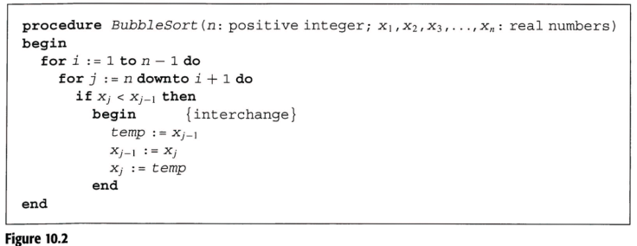

Slide 10
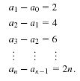
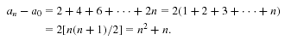
The First-Order Linear Recurrence Relation
Ex 10.6 : In Example 9.6 we sought the generating function for the sequence 0, 2, 6, 12, 20, 30, 42,…, due to the observation a_{n} = n² + n. If we fail to see this, alternatively

Slide 11
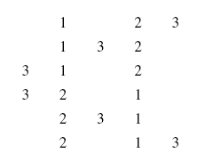
The First-Order Linear Recurrence Relation
Ex 10.7 : Solve the relation a_{n} = n.a_{n-1}, n ≥ 1, a₀ = 1.

Slide 12
The Second-Order Linear Homogeneous Recurrence Relation with Constant Coefficients
Linear recurrence relation of order k:
C₀a_{n}+C₁a_{n-1}+C₂a_{n-2}+…+C_{k}a_{n-k} = f(n), n ≥ 0.
Homogeneous relation of order 2:
C₀a_{n}+C₁a_{n-1}+C₂a_{n-2} = 0, n ≥ 2.
Substituting a_{n} = cr^{n} into the equation, we have
C₀cr^{n} + C₁cr^{n-1} + C₂cr^{n-2} = 0, n ≥ 2.
Characteristic equation: C₀r² + C₁r + C₂ = 0, n ≥ 2.
The roots r₁, r₂ of this equation are called characteristic roots.
Three cases for the roots:
distinct real roots
complex conjugate roots
equivalent real roots

Slide 13
Case (A): Distinct Real Roots
Ex 10.9 : Solve the recurrence relation a_{n} + a_{n-1} - 6a_{n-2} = 0, n ≥ 2, and a₀ = -1 and a₁ = 8.
Solution
Let a_{n} = cr^{n}
r² + r - 6 = 0 ⇒ r = 2, -3
a_{n} = c₁(2)^{n} + c₂(-3)^{n}
-1 = a₀ = c₁ + c₂
8 = a₁ = 2c₁ - 3c₂ ⇒ c₁ = 1, c₂ = -2
⇒ a_{n} = (2)^{n} - 2(-3)^{n}
a_{n}=2^{n} and a_{n}=(-3)^{n} are both solutions
Linearly independent solutions

Slide 14
Distinct Real Roots
Ex 10.10 : Solve Fibonacci relation, F_{n+2} = F_{n+1} + F_{n}, n ≥ 0, F₀ = 0, F₁ = 1.
Solution
Let F_{n} = cr^{n},
r² - r - 1 = 0 ⇒

Slide 15
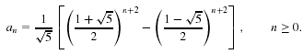
Distinct Real Roots
Ex 10.11 : For n ≥ 0, let S = {1, 2, …, n}, and let a_{n} denote the number of subsets of S that contains no consecutive integers. Find and solve a recurrence relation for a_{n}.
Solution
a₀ = 1 and a₁ = 2 and a₂ = 3 and a₃ = 5 (Fibonacci?)
If A ⊆ S and A is to be counted in a_{n}, there are two cases
(1) n∈A, then A - {n} would be counted in a_{n-2}
(2) n∉A, then A would be counted in a_{n-1}
a_{n} = a_{n-1}+ a_{n-2} , n ≥ 2
A
n ∈ A
n ∉ A
Exhaustive and mutually disjoint

Slide 16
Distinct Real Roots
Ex 10.12 : Suppose we have a 2×n chessboard. We wish to cover such a chessboard using 2×1 vertical dominoes or 1×2 horizontal dominoes.
b₁
b₂

Slide 17
Distinct Real Roots
Let b_{n} count the number of ways we can cover a 2×n chessboard by using 2×1 vertical dominoes or 1×2 horizontal dominoes.
b₁=1 and b₂=2
For n ≥ 3, consider the last (nth) column of the chessboard
By one 2×1 vertical domino: Now the remaining 2 ×(n -1) subboard can be covered in b_{n-1} ways.
By two 1×2 horizontal dominoes, place one above the other: Now the remaining 2 ×(n -2) subboard can be covered in b_{n-2} ways.
b_{n}= b_{n-1} + b_{n-2}, n ≥ 3, b₁=1 and b₂=2 ⇒ b_{n} = F_{n+1}
b_{n-1}
b_{n-2}

Slide 18
Distinct Real Roots
Ex 10.14 : Suppose the symbols of legal arithmetic expressions include 0, 1,…, 9, +, *, /.
Let a_{n} be the number of legal arithmetic expressions that are made up of n symbols.
a₁=10 and a₂=100
For n≥3, consider the two cases of length n -1:
If x is an expression of n -1 symbols, add a digit to the right of x. ⇒ 10a_{n-1}
If x is an expression of n - 2 symbols, we adjoin to the right of x one of the 29 two-symbol expressions: +0, …, +9, *0, …,*9, /1, /2,…, /9. ⇒ 29a_{n-2}
a_{n} = 10a_{n-1} + 29a_{n-2}, n ≥ 3

Slide 19
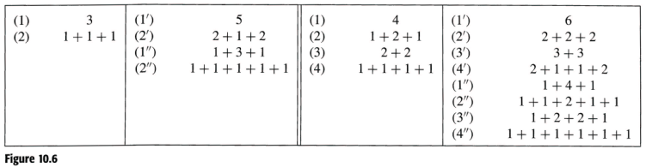
Distinct Real Roots
Ex 10.15 : Palindromes are the compositions of numbers that read the same left to right as right to left. (Figure 10.6)
Let p_{n} count the number of palindromes of n.
p_{n} = 2p_{n-2}, n ≥ 3, p₁=1, p₂=2
Notes:
9.13 補充

Slide 20
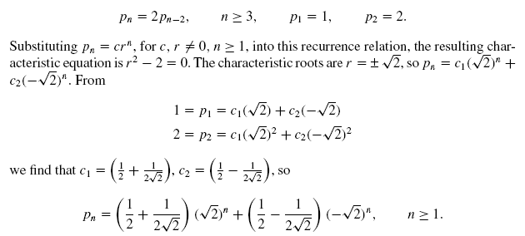
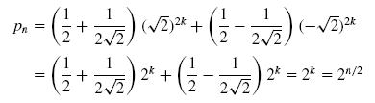
Distinct Real Roots

Slide 21
Distinct Real Roots
Ex 10.16 : Find the number of recurrence relation for the number of binary sequences of length n that have no consecutive 0’s.
Let a_{n} be the number of such sequences of length n.
Let a_{n}⁽⁰⁾ count those end in 0, and a_{n}⁽¹⁾ count those end in 1 ⇒ a_{n} = a_{n}⁽¹⁾ + a_{n}⁽⁰⁾
Consider x of length n -1
If x ends in 1, we can append a 0 or a 1 to it (2a_{n-1}⁽¹⁾).
If x ends in 0, we can append a 1 to it (a_{n-1}⁽⁰⁾).
a_{n} = 2a_{n-1}⁽¹⁾ + a_{n-1}⁽⁰⁾ = a_{n-1}⁽¹⁾ + a_{n-1}⁽¹⁾ + a_{n-1}⁽⁰⁾
If y is counted in a_{n-2} ⇔ sequence y1 is counted in a_{n-1}⁽¹⁾
So, a_{n-2} = a_{n-1}⁽¹⁾.
a_{n} = a_{n-1}+ a_{n-2}, n≥3, a₁=2, a₂=3
a_{n-1}

Slide 22
Second- or Higher-Order Recurrence Relation
Ex 10.18 : Solve 2a_{n+3} = a_{n+2} + 2a_{n+1} - a_{n}, n≥0, a₀=0, a₁=1,, a₂=2
Let a_{n} = cr^{n}
Characteristic equation: 2r³-r²-2r+1=0 ⇒ r = 1, 1/2, -1
a_{n} = c₁(1)^{n} + c₂(-1)^{n} + c₃(1/2)^{n}
From a₀=0, a₁=1,, a₂=2, derive c₁=5/2, c₂=1/6,, c₃=-8/3
a_{n} = (5/2)+(1/6)(-1)^{n}+(-8/3)(1/2)^{n}

Slide 23
Second- or Higher-Order Recurrence Relation
Ex 10.19 : We want to tile a 2×n chessboard using two types of tiles shown in Figure 10.8.
a₂: 2×2 chessboard

Slide 24
Second- or Higher-Order Recurrence Relation
Let a_{n} count the number of such tilings.
a₁=1 and a₂=5 and a₃=11
For n ≥ 4, consider the last column of the chessboard
the nth column is covered by two 1×1 tiles ⇒ a_{n-1}
the (n -1)st and the nth column are tiled with one 1×1 tile and a larger tile ⇒ 4a_{n-2}
the (n - 2)nd, (n - 1)st and the nth columns are tiled with two large tiles ⇒ 2a_{n-3}
a_{n} = a_{n-1}+ 4a_{n-2} + 2a_{n-3}, n≥4
a_{n-2}
a_{n-3}
Notes:
Draw a3

Slide 25
Case (B): Complex Roots
DeMoivre’s Theorem: (cosθ + i sinθ)^{n} = cosnθ + i sinnθ

Slide 26
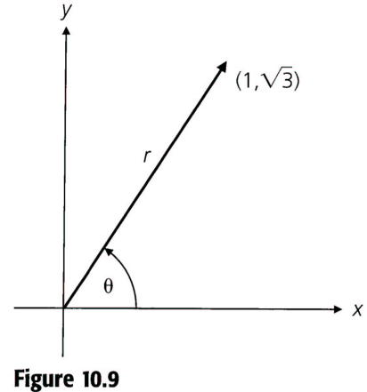
Complex Roots
Ex 10.20 : Determine
Solution

Slide 27
Complex Roots
Ex 10.21 : Solve the recurrence relation a_{n} = 2(a_{n-1} - a_{n-2}) where n≥2, a₀ = 1, a₁ = 2.
Let a_{n} = cr^{n}
r² - 2r + 2 = 0 ⇒ r = 1 ± i
1 + i = (cos(π/4) + i sin(π/4))
1 - i = (cos(π/4) - i sin(π/4))

Slide 29
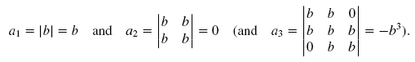
Complex Roots
Ex 10.22 : Let a_{n} denote the value of the n×n determinant D_{n}
a₁ = b, a₂ = 0 and a₃ = -b³
D_{n} = bD_{n-1} - b²D_{n-2}
a_{n} = ba_{n-1} - b²a_{n-2}
=

Slide 31
Case (C): Repeated Real Roots
Ex 10.23 : Solve the recurrence relation a_{n+2} = 4a_{n+1} - 4a_{n} where n≥0, a₀=1, a₁=3
Solution
Let a_{n} = cr^{n}
r² - 4r + 4 = 0 ⇒ r = 2 ⇒ 2^{n} and 2^{n} are not independent solutions, need another independent solution
So, try g(n)2^{n} , where g(n) is not a constant
⇒ g(n+2)2^{n+2} = 4g(n+1)2^{n+1} - 4g(n)2^{n}
⇒ g(n+2) = 2g(n+1) - g(n) ⇒ g(n) = n,∴n2^{n} is a solution
a_{n} = c₁(2^{n}) + c₂(n2^{n}) with a₀=1, a₁=3
a_{n} = 1(2^{n}) + (1/2)(n2^{n})

Slide 32
Repeated Real Roots
In general, if
C₀a_{n} + C₁a_{n-1} + C₂a_{n-2} + …+ C_{k}a_{n-k} = 0
with r, a characteristic root of multiplicity m, then the part of the general solution that involves the root r has the form
A₀r^{n} + A₁nr^{n} + A₂n²r^{n} + A₃n³r^{n} + … + A_{m-1}n^{m-1}r^{n}
=(A₀ + A₁n + A₂n² + A₃n³ + … + A_{m-1}n^{m-1})r^{n}

Slide 33
Repeated Real Roots
Ex 10.24 : Let p_{n} denote the probability that at least one case of measles is reported during the nth week after the first recorded case. School records provide evidence that p_{n}= p_{n-1} - (0.25)p_{n-2}, for n≥2. Since p_{n}= 0 and p₁= 1, if the first case is recorded on Monday, March 3, 2003, when did the probability for the occurrence of a new case decrease to less than 0.01 for the first time?
Solution
Let p_{n} = cr^{n}
r² - r + (1/4) = 0 ⇒ r = 1/2
p_{n} = (c₁ + c₂n)(1/2)^{n} ⇒ c₁= 0 and c₂= 2 ⇒ p_{n} = n2^{-n+1}
p_{n} < 0.01 ⇒ the first n is 12, the week of May 19, 2003.

Slide 34
10.3 The Nonhomogeneous Recurrence Relation
a_{n} + C₁a_{n-1} = f(n), n≥1,
a_{n} + C₁a_{n-1} + C₂a_{n-2} = f(n), n≥2
Let a_{n}^{(h)} denote the general solution of the associated homogeneous relation.
Let a_{n}^{(p)} denote a solution of the given nonhomogeneous relation. (particular solution)
Then a_{n} = a_{n}^{(h)} + a_{n}^{(p)} is the general solution of the recurrence relation.

Slide 35
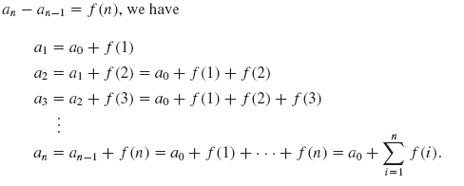
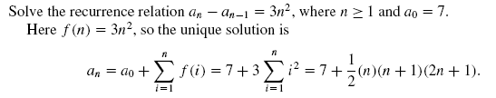
The Nonhomogeneous Recurrence Relation
Ex 10.25

Slide 36
The Nonhomogeneous Recurrence Relation
Ex 10.26 : Solve the recurrence relation a_{n} - 3a_{n-1} = 5(7^{n}) for n≥1 and a₀ = 2.
Solution
The solution for a_{n} - 3a_{n-1} = 0 is a_{n}^{(h)} = c(3^{n}).
Since f(n) = 5(7^{n}), let a_{n}^{(p)} = A(7^{n})
⇒ A(7^{n}) - 3A(7^{n-1}) = 5(7^{n}) ⇒ A = 35/4
a_{n}^{(p)} = (35/4)7^{n} = (5/4)7^{n+1}.
The general solution is a_{n} = a_{n}^{(h)} + a_{n}^{(p)} = c(3^{n}) + (5/4)7^{n+1}
So, a_{n} = (-1/4)(3^{n+3}) + (5/4)7^{n+1}

Slide 37
The Nonhomogeneous Recurrence Relation
Ex 10.27 : Solve the recurrence relation a_{n} - 3a_{n-1} = 5(3^{n}) for n≥1 and a₀ = 2.
Solution
Let a_{n}^{(h)} = c(3^{n}).
Since a_{n}^{(h)} and f(n) are not linearly independent, let a_{n}^{(p)} = Bn(3^{n}) ⇒ Bn(3^{n}) - 3B(n-1)(3^{n-1}) = 5(3^{n}). ⇒ B=5.
The general solution is a_{n}= a_{n}^{(h)} + a_{n}^{(p)} = c(3^{n})+ (5)n3^{n+1}
a_{n} = (2 + 5n)(3^{n})

Slide 38
Solution for the Nonhomogeneous First-Order Relation
a_{n} + C₁a_{n-1} = kr^{n}.
If r^{n} is not a solution of the homogeneous relation a_{n} + C₁a_{n-1} = 0, then a_{n}^{(p)} = Ar^{n}.
If r^{n} is a solution of the homogeneous relation, then a_{n}^{(p)} = Bnr^{n}.

Slide 39
Solution for the Nonhomogeneous Second-Order Relation
a_{n} + C₁a_{n-1} + C₂a_{n-2} = kr^{n}.
If r^{n} is not a solution of the homogeneous relation, then a_{n}^{(p)} = Ar^{n}.
If a_{n}^{(h)} = c₁r^{n} + c₂r₁^{n}, where r ≠ r₁, then a_{n}^{(p)} = Bnr^{n}.
If a_{n}^{(h)} = (c₁ + c₂n)r^{n}, then a_{n}^{(p)} = Cn²r^{n}.

Slide 40
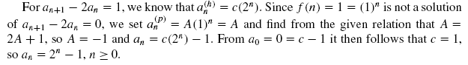
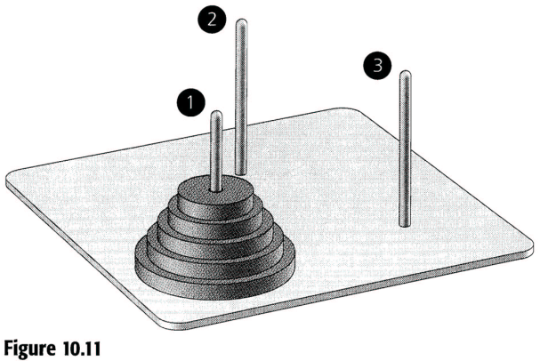
The Nonhomogeneous Recurrence Relation
Ex 10.28 : The Towers of Hanoi.
Let count the minimum number of moves it takes to transfer n disks from peg 1 to peg 3.
a_{n+1} = 2a_{n} + 1
Transfer the top n disks from peg 1 to peg 2, need a_{n} moves.
Transfer the largest disk from peg 1 to peg 3, need 1 moves.
Transfer the n disks on peg 2 onto the largest disk, need a_{n} moves.

Slide 41
The Nonhomogeneous Recurrence Relation
Ex 10.29 : Let a_{n} denote the amount still owed on the loan at the end of the nth period. (r is the interest rate, P is payment, S is loan)
a_{n+1} = a_{n} + ra_{n} - P, 0≤ n ≤ T-1, a₀ = S, a_{T} = 0
a_{n}^{(h)} = c(1+r)^{n}.
Let a_{n}^{(p)} = A, A - (1+r)A = -P ⇒ A = P/r, a_{n}^{(p)} = P/r.
a_{n} = a_{n}^{(h)} + a_{n}^{(p)} = c(1+r)^{n} + P/r ⇒ c = S - (P/r)
a_{n} = (S - (P/r))(1+r)^{n}+(P/r)
Since 0 = a_{T}, we have P = (Sr)[1 - (1 + r)^{-T}]⁻¹

Slide 42
The Nonhomogeneous Recurrence Relation
Ex 10.30 : Let S be a set containing 2^{n} real numbers. Find the maximum and minimum in S. We wish to determine the number of comparisons made between pairs of elements in S.
Let a_{n} denote the number of needed comparisons.
n = 2, |S| = 2² = 4, S = {x₁, x₂, y₁, y₂} = S₁∪S₂,
S₁ = {x₁, x₂}, S₂ = {y₁, y₂}
a_{n+1} = 2a_{n}+2, n≥1.
a_{n}^{(h)} = c(2^{n}) , a_{n}^{(p)} = A
a₁=1➔ a_{n} = (3/2)(2^{n}) - 2

Slide 43
The Nonhomogeneous Recurrence Relation
Ex 10.31 : For the alphabet = {0,1,2,3}, how many strings of length n contains an even number of 1’s.
Let a_{n} count those strings among the 4^{n} strings.
Consider the nth symbol of a string of length n
The nth symbol is 0, 2, 3 ⇒ 3a_{n-1}
The nth symbol is 1 ⇒ there must be an odd number of 1’s among the first n -1 symbols ⇒ 4^{n-1} - a_{n-1}
a_{n} = 3a_{n-1} + (4^{n-1} - a_{n-1}) = 2a_{n-1} + 4^{n-1}
a_{n}^{(h)} = c(2^{n}) , a_{n}^{(p)} = A(4^{n-1})
a₁=3➔ a_{n} = 2^{n-1}+ 2(4^{n-1})

Slide 44
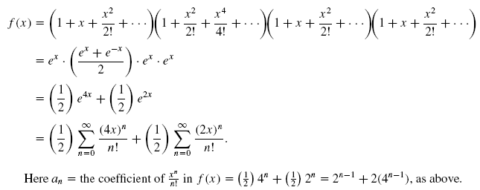
The Nonhomogeneous Recurrence Relation

Slide 45
The Nonhomogeneous Recurrence Relation
Ex 10.32 : Snowflake curve shown in Figure 10.12.
Let a_{n} denote the area of the polygon P_{n} obtained from the original equilateral triangle after we apply n transformations.
#segment in each side

Slide 46
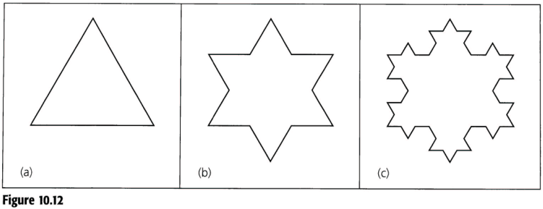
S/3
S
S/3
A special kind of fractal curves
1904, Helge von Koch
http://en.wikipedia.org/wiki/Koch_snowflake

Slide 47
The Nonhomogeneous Recurrence Relation
Ex 10.34 : Solve the recurrence relation a_{n+2} - 4a_{n+1} + 3a_{n} = -200 for n≥0 and a₀ = 3000 and a₁ = 3300.
Solution
a_{n}^{(h)} = c₁(3^{n}) + c₂(1^{n}).
Let a_{n}^{(p)} = An ⇒ A(n+2) - 4A(n+1) + 3An = -200
⇒ a_{n}^{(p)} = 100n.
a_{n}= a_{n}^{(h)} + a_{n}^{(p)} = c₁(3^{n}) + c₂(1^{n})+100n
⇒ a_{n}= 100(3^{n})+2900+100n
Notes:
Why An? and also can solve A
* Test answer to explain ah and ap

Slide 48
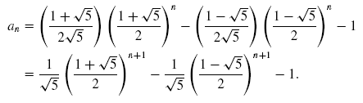
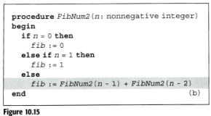
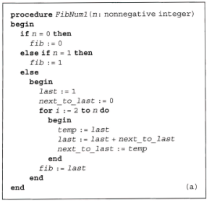
The Nonhomogeneous Recurrence Relation
Two procedures of computing the nth Fibonacci number in Figure 10.15. Which one is more efficient?
a_{n} = a_{n-1} + a_{n-2} + 1

Slide 49
Particular Solutions to Nonhomogeneous Recurrence Relation
C₀a_{n} + C₁a_{n-1} + C₂a_{n-2} + …+ C_{k}a_{n-k} = f(n)
(1) If f(n) is a constant multiple of one of the forms in the first column of Table 10.2 ⇒ a_{n}^{(p)} in the second column .
(2) When f(n) comprises a sum of constant multiples of terms.
E.g., f(n) = n²+ 3sin 2n ⇒ a_{n}^{(p)} = (A₂n²+A₁n+A₀) + (A sin 2n+ Bcos 2n)
(3) If a summand f₁(n) of f(n) is a solution of the associated homogeneous relation.
If f₁(n) causes this problem, we multiply the trial solution (a_{n}^{(p)})₁ corresponding to f₁(n) by the smallest power of n, say n^{s}, for which no summand of n^{s}f₁(n) is a solution of the associated homogeneous relation. Thus, n^{s}(a_{n}^{(p)})₁ is the corresponding part of a_{n}^{(p)}.

Slide 50
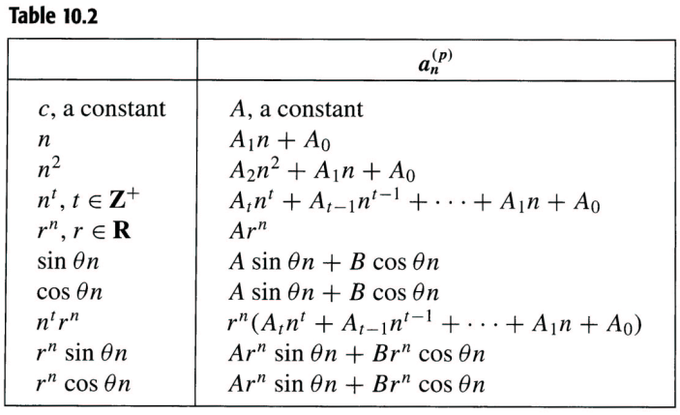

Slide 51
Particular Solutions to Nonhomogeneous Recurrence Relation
Ex 10.36 : For n people at a party, each of them shakes hands with others.
a_{n} counts the total number of handshakes:
a_{n+1} = a_{n} + n, n ≥ 2, a₂ = 1
a_{n}^{(h)} = c(1^{n}) = c.
Let a_{n}^{(p)} = A₁n + A₀
By the third remark stated above, multiplying a_{n}^{(p)} by n¹, then a_{n}^{(p)} = A₁n² + A₀n
A₁ = ½ , A₀ = -½ ⇒ a_{n}^{(p)} = (½)n² + (- ½)n.
a_{n}= a_{n}^{(h)} + a_{n}^{(p)} = c + (½)n² + (-½)n ⇒ c =0
a_{n} = (½)n(n-1)

Slide 52
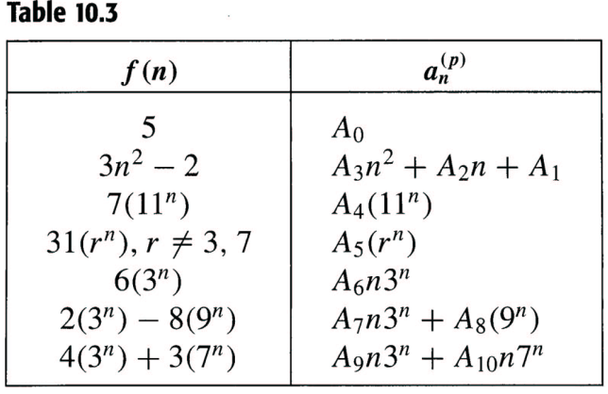
Particular Solutions to Nonhomogeneous Recurrence Relation
Ex 10.37 : a_{n+2} - 10a_{n+1} + 21a_{n} = f(n), n≥0
a_{n}^{(h)} = c₁(3^{n}) + c₂(7^{n}).

Slide 53
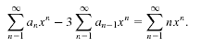
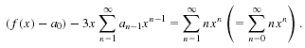
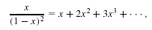
10.4 The Method of Generating Functions
Ex 10.38 : Solve the relation a_{n} - 3a_{n-1} = n, n ≥ 1, a₀ = 1.
Let f(x) = be the generating function for a₀, a₁,…, a_{n}.

Slide 54
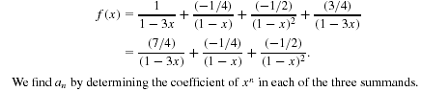
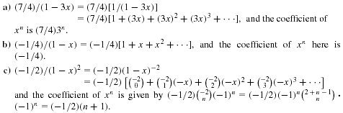
Notes:
Compare with characteristic method

Slide 55
The Method of Generating Functions
Ex 10.39 : Solve the relation a_{n+2} - 5a_{n+1} + 6a_{n} = 2, n ≥ 0, a₀ = 3, a₁ = 7.
Let f(x)= be the generating function for a₀, a₁,…, a_{n}

Slide 56
Notes:
Try to solve by characteristics function

Slide 57
The Method of Generating Functions
Ex 10.40 : Let a(n, r) = the number of ways we can select, with repetitions allowed, r objects from a set of n distinct objects.
Let {b₁, b₂,…, b_{n}} be the set, consider b₁
b₁ is never selected: the r objects from {b₂,…, b_{n}} ⇒ a(n - 1, r)
b₁ is selected at least once: must select r -1 objects from {b₁, b₂,…, b_{n}} ⇒ a(n, r - 1)
Then a(n, r) = a(n-1, r) + a(n, r-1).
Let f_{n} = be the generating function for a(n, 0), a(n, 1), a(n, 2),…,

Slide 58
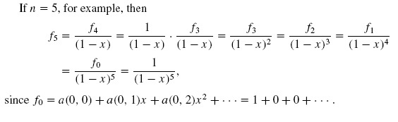

Slide 59
10.5 A Special Kind of Nonlinear Recurrence Relation
Ex 10.42 : Let b_{n} denote the number of rooted ordered binary trees on n vertices.
b₃ = 5 is shown in Figure 10.18.
b_{n+1} = b₀b_{n} + b₁b_{n-1} +…+ b_{n-1}b₁ + b_{n}b₀
Let f(x) = be the generating function for b₀, b₁,…, b_{n}.

Slide 60
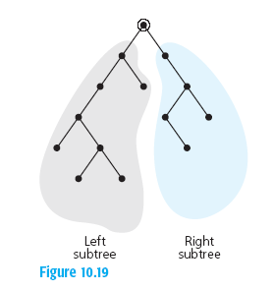
A Special Kind of Nonlinear Recurrence Relation
b_{n+1} = b₀b_{n} + b₁b_{n-1} +…+ b_{n-1}b₁ + b_{n}b₀
0 vertices on the left, n vertices on the right ⇒ b₀b_{n}
1 vertices on the left, n -1 vertices on the right ⇒ b₁b_{n-1}
i vertices on the left, n - i vertices on the right ⇒ b_{i}b_{n - i}
n vertices on the left, none on the right ⇒ b_{n}b₀

Slide 61
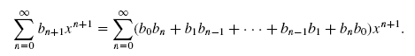

Slide 63
b_{n} are called Catalan numbers

Slide 64
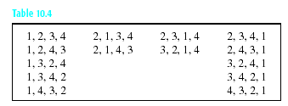
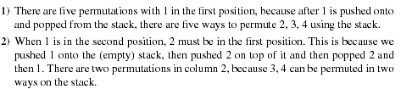
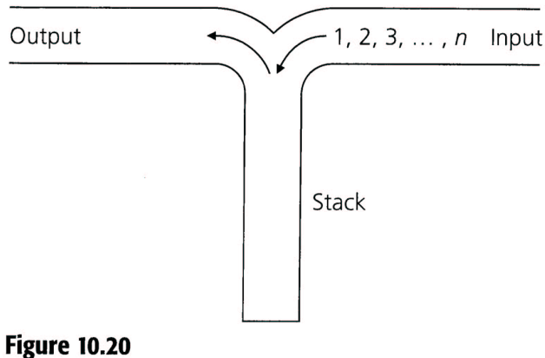
A Special Kind of Nonlinear Recurrence Relation
Ex 10.43 : permute 1, 2, 3,…, n, which must be pushed onto the top of the stack in the order given.
n = 0 ⇒ 1
n = 1 ⇒ 1
n = 2 ⇒ 2
n = 3 ⇒ 5
n = 4 ⇒ 14
a₄ = a₀a₃ + a₁a₂ + a₂a₁ + a₃a₀
Notes:
123,132, 213, 321, 231

Slide 65
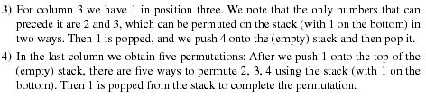
A Special Kind of Nonlinear Recurrence Relation
a₄ = a₀a₃ + a₁a₂ + a₂a₁ + a₃a₀
a_{n+1} = a₀a_{n} + a₁a_{n-1} +…+ a_{n-1}a₁ + a_{n}a₀

Slide 66
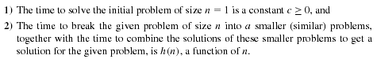
10.6 Divide-and-Conquer Algorithms
In general, solve a given problem of size n by
Solving the problem for a small value of n directly.
Breaking the problem into a smaller problems of the same type and the same size
Divide-and-conquer algorithms
Time complexity function f(n)
f(1) = c
f(n) = af(n/b) + h(n) for n = b^{k}

Slide 67
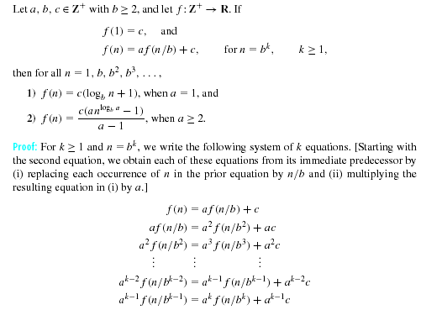
Divide-and-Conquer Algorithms
Theorem 10.1:

Slide 69
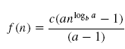
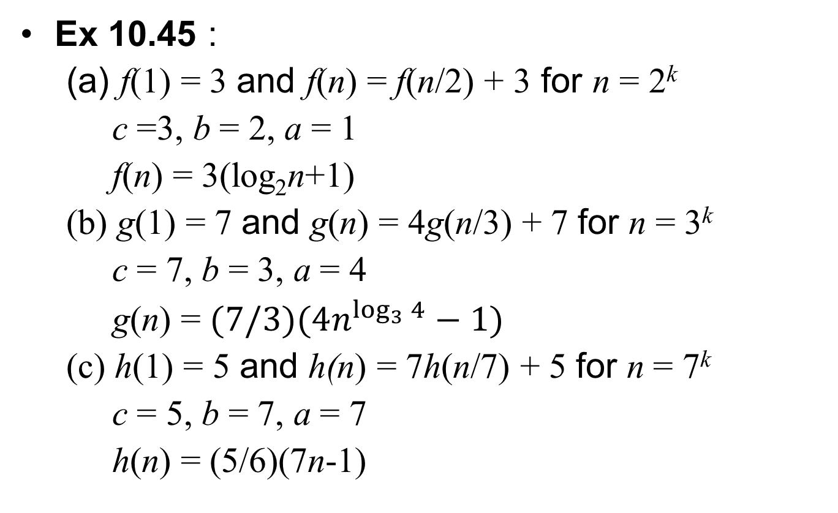
Divide-and-Conquer Algorithms
Ex 10.45 :
(a) f(1) = 3 and f(n) = f(n/2) + 3 for n = 2^{k}
c =3, b = 2, a = 1
f(n) = 3(log₂n+1)
(b) g(1) = 7 and g(n) = 4g(n/3) + 7 for n = 3^{k}
c = 7, b = 3, a = 4
g(n) = $(7/3)(4n^{\log_{3}{4}}−1)$
(c) h(1) = 5 and h(n) = 7h(n/7) + 5 for n = 7^{k}
c = 5, b = 7, a = 7
h(n) = (5/6)(7n-1)

Slide 70
Homework (optional)
10.2: 10, 12, 30
10.3: 6, 8
10.4: 2

